Slide 1


Introduction to Elastic Stack
Mr. Iyanou Eraste AKANDE Elastic Certified Engineer Data Engineer at Synaptique Maghreb

Slide 2
The Beginning
Lucene
Compass
Elasticsearch
1999 Doug Cutting Search Engine in Java
2004 Shay Banon Search Product in Java, scalability included, built on Lucene
2010 Shay Banon Search product built on Compass concepts, distributed and integrated with other language

Slide 3
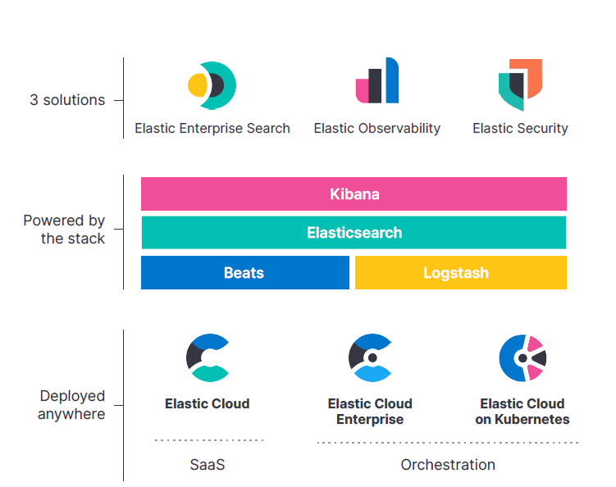
Elastic Stack Components
Elasticsearch : NoSQL Database
Kibana : Analytics and Visualization platform
Logstash : Server side data processing pipeline
Beats : Data Shippers (Filebeat, Metricbeat, Heartbeat, Elastic Agents)

Slide 4














Elastic Partners
https://partners.elastic.co/findapartner/
Introduction to Elastic Stack

Slide 5




Elastic Stack Use Cases
Log Management and Analysis: One of the primary use cases for Elastic Stack is log management and analysis. Organizations use it to collect, parse, index, and analyze logs generated by various systems, applications, and services.
Security Information and Event Management (SIEM): Elastic Stack can be used as a SIEM solution to collect, analyze, and visualize security-related data such as logs, network traffic, and system events.
Real-time Monitoring and Alerting: Elastic Stack can be utilized for real-time monitoring of infrastructure, applications, and services. By collecting metrics, logs, and events in real-time, organizations can set up alerts and notifications.
Application Performance Monitoring (APM): Elastic APM, an extension of the Elastic Stack, is used for monitoring the performance of applications and microservices.
Introduction to Elastic Stack

Slide 6



Elastic Stack Use Cases
Business Analytics and Insights: Elastic Stack can be leveraged for business analytics and data visualization purposes. By indexing and analyzing large volumes of data from different sources, organizations can gain valuable insights into customer behavior, market trends, and operational performance.
Search and Information Retrieval: Elasticsearch supports full-text search, fuzzy search, geospatial search, and faceted navigation, making it suitable for building search-driven applications and platforms.
Data Exploration and Discovery: Elastic Stack can be used for data exploration and discovery in various domains such as scientific research, e-commerce, and content management.
Introduction to Elastic Stack

Slide 7

Elasticsearch
NoSQL Database
{
“first_name” : “Ali”,
“name” : “KOZNI”,
“gender” : “M”,
“city” : “Rabat”,
“country” : “Morocco”
},
{
“first_name” : “Achille”,
“name” : “BADRE”,
“gender” : “F”,
“city” : “Tetouan”,
“country” : “Morocco”
}
first_ame | name | gender | city | country
Ali | KOZNI | M | Rabat | Morocco
Achille | BADRE | F | Tetouan | Morocco
Introduction to Elastic Stack

Slide 8
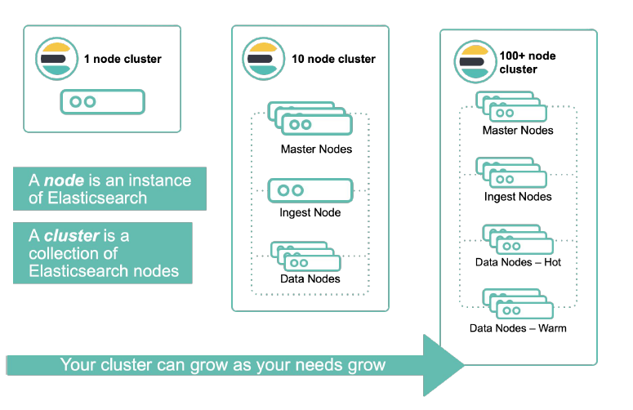
Elasticsearch
Distributed and Horizontally Scalable
Introduction to Elastic Stack

Slide 9

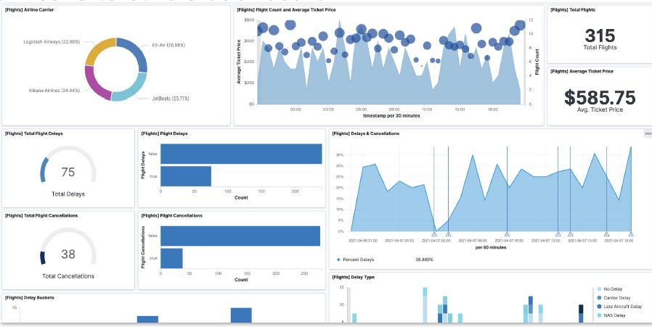
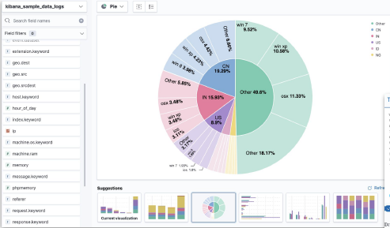
Kibana
Analytics and Visualization Platform
Introduction to Elastic Stack

Slide 10

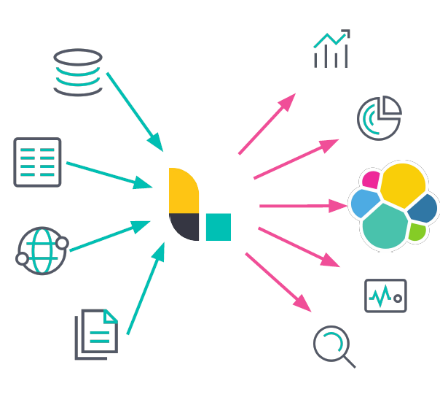
Logstash
Data Processing Pipeline
Introduction to Elastic Stack

Slide 11

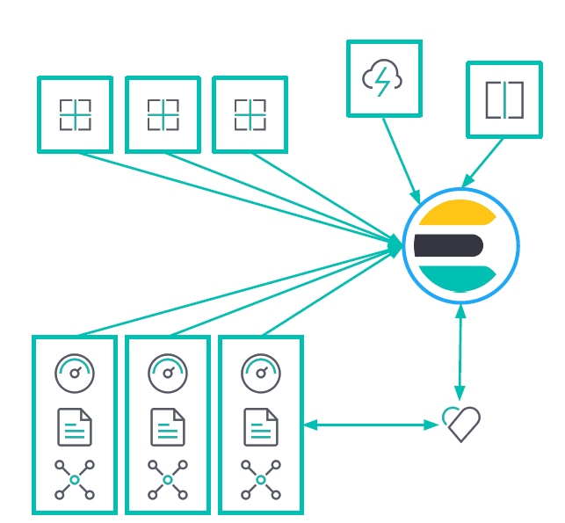
Beats
Open Source Data Shippers
Filebeat, Metricbeat, Heartbeat, Packetbeat, Winlogbeat, etc.
Introduction to Elastic Stack

Slide 12
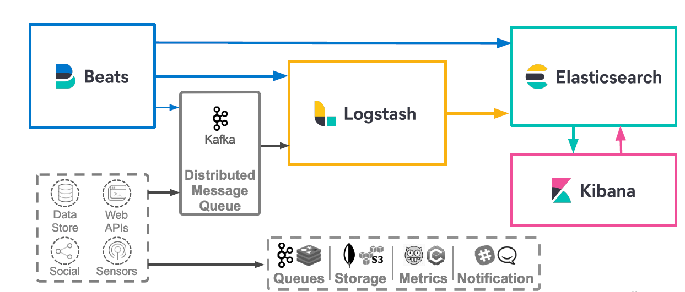
Elastic Stack Architecture
Introduction to Elastic Stack

Slide 13

Questions

Slide 14
Thank you
Mr. Iyanou Eraste AKANDE
eraste.akande@gmail.com

